Slide 1



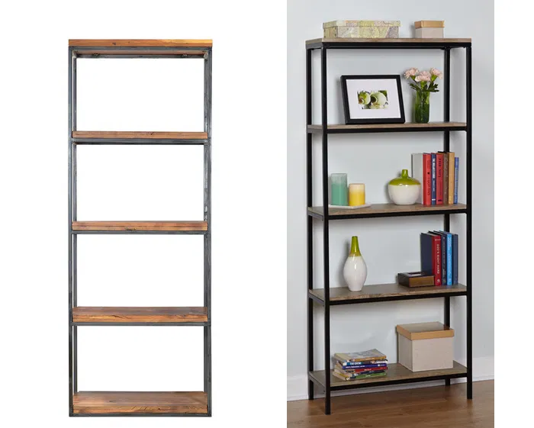
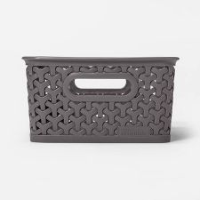
Welcome to my
Classroom Management Plan
(Click on each bin below to explore)
Patricia Wagner
Description
Classroom
Arrangement
Behavior
expectation
Establishing Rapport
LEarning
PRocess
Responding to
behavior
Reinforcement
/Feedback
Screening for RTI

Slide 2


Description
This classroom management plan is for a 3rd grade class. As a 3rd grade teacher, and overall as an early childhood education teacher, I will often be tasked with teaching several or all content areas to students.
My classroom and our school are made up of a diverse student population. With many students of different races, students from different socioeconomic backgrounds, students with learning disabilities and students with different first languages and language capabilities.
Students will be seated in desk groups of three. During class students may be asked to work with their group members to complete formative assessments or review activities like Think-pair-shares or vocab quiz reviews. Students may also be asked to work individually on activities such as journal entries and summative assessments.
Notes:
Rubric Expectation for Description of grade Context and structure of learning process.
Explicitly clear, complete and accurate statement about 1) grade level and course content, 2) diversity in classroom and school, 3) use of group and individual work, 4) active learning activities and 5) other relevant aspects of learning environment.

Slide 3
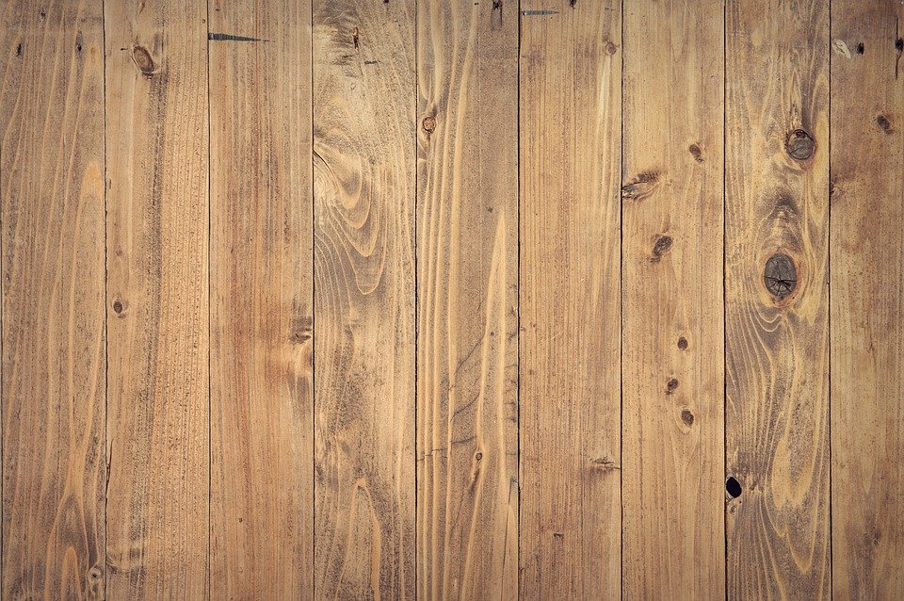
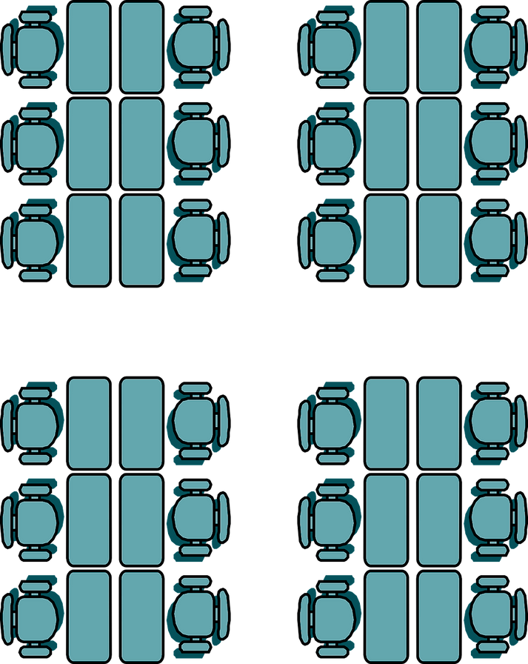

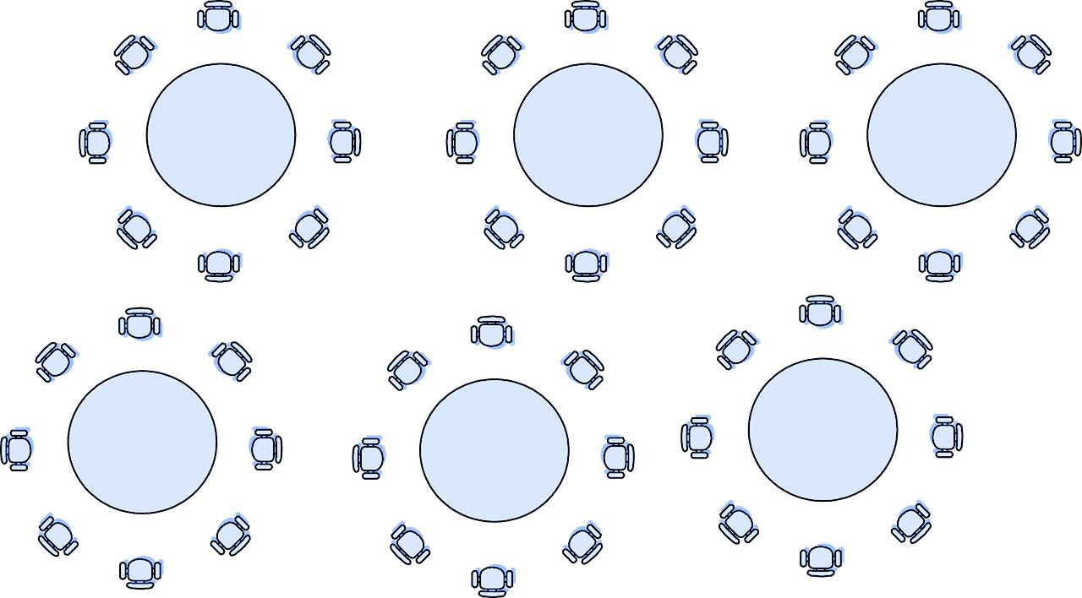
Behavior Expectations Poster
White Board
Teacher Desk
Student Desks
Bookshelf
Student
Resource Center
Bookshelf
Small Group
Chalk Board
Student Cubbies
Bulletin Board
Student Cubbies
Notes:
Rubric Expectations for Physical Arrangement of Classroom
Explicitly clear, complete and accurate statement about 1) the physical set up of the room, 2) a diagram of the room, and 3) rationale regarding why the room was arranged as described (including placement of expectations and how arrangement helps with behavior management).

Slide 4
Behavior Expectations Poster
White Board
Teacher Desk
The teacher’s desk is located here because it puts the teacher in the perfect location to watch students while they work while still remaining visible to students while they are seated at their desks.
Bookshelf
Student
Resource Center
Bookshelf
Chalk Board
Student Cubbies
Bulletin Board
Student Cubbies
Notes:
Rubric Expectations for Physical Arrangement of Classroom
Explicitly clear, complete and accurate statement about 1) the physical set up of the room, 2) a diagram of the room, and 3) rationale regarding why the room was arranged as described (including placement of expectations and how arrangement helps with behavior management).

Slide 5
Behavior Expectations Poster
White Board
Teacher Desk
The behavior expectation poster is located here because it is able to be placed eye level for students and it is at the front of the room where they face at their desks. This makes it easy for students to reference and for the teacher to use it as a reminder.
Bookshelf
Student
Resource Center
Bookshelf
Chalk Board
Student Cubbies
Bulletin Board
Student Cubbies
Notes:
Rubric Expectations for Physical Arrangement of Classroom
Explicitly clear, complete and accurate statement about 1) the physical set up of the room, 2) a diagram of the room, and 3) rationale regarding why the room was arranged as described (including placement of expectations and how arrangement helps with behavior management).

Slide 6
Behavior Expectations Poster
White Board
Teacher Desk
The white board is located here because it is the front of the room, the whiteboard is used every day during lessons and this is the direction that the students face.
Bookshelf
Student
Resource Center
Bookshelf
Chalk Board
Student Cubbies
Bulletin Board
Student Cubbies
Notes:
Rubric Expectations for Physical Arrangement of Classroom
Explicitly clear, complete and accurate statement about 1) the physical set up of the room, 2) a diagram of the room, and 3) rationale regarding why the room was arranged as described (including placement of expectations and how arrangement helps with behavior management).

Slide 7
Behavior Expectations Poster
White Board
Teacher Desk
Student Desks
Bookshelf
Student
Resource Center
The student desks are located here because they face the whiteboard and it is located in the front of the room and is used during daily instruction.
Bookshelf
Chalk Board
Student Cubbies
Bulletin Board
Student Cubbies
Notes:
Rubric Expectations for Physical Arrangement of Classroom
Explicitly clear, complete and accurate statement about 1) the physical set up of the room, 2) a diagram of the room, and 3) rationale regarding why the room was arranged as described (including placement of expectations and how arrangement helps with behavior management).

Slide 8
Behavior Expectations Poster
White Board
Teacher Desk
Student Desks
The small group table is located here because here the teacher will be able to work with small groups without distracting the other students while they work and will also be able to keep an eye on the other students.
Bookshelf
Student
Resource Center
Bookshelf
Small Group
Chalk Board
Student Cubbies
Bulletin Board
Student Cubbies
Notes:
Rubric Expectations for Physical Arrangement of Classroom
Explicitly clear, complete and accurate statement about 1) the physical set up of the room, 2) a diagram of the room, and 3) rationale regarding why the room was arranged as described (including placement of expectations and how arrangement helps with behavior management).

Slide 9
Behavior Expectations Poster
White Board
Teacher Desk
Student Desks
Bookshelf
Student
Resource Center
The student cubbies are located here because students keep their items in the classroom but they keep them in cubbies so that they are out of the way and not a distraction.
Bookshelf
Small Group
Chalk Board
Student Cubbies
Bulletin Board
Student Cubbies
Notes:
Rubric Expectations for Physical Arrangement of Classroom
Explicitly clear, complete and accurate statement about 1) the physical set up of the room, 2) a diagram of the room, and 3) rationale regarding why the room was arranged as described (including placement of expectations and how arrangement helps with behavior management).

Slide 10
Behavior Expectations Poster
White Board
Teacher Desk
Student Desks
Bookshelf
Student
Resource Center
The bulletin board is located here because when the students come in each day, they can look at the bulletin board as they’re putting their things in their cubbies.
Bookshelf
Small Group
Chalk Board
Student Cubbies
Bulletin Board
Student Cubbies
Notes:
Rubric Expectations for Physical Arrangement of Classroom
Explicitly clear, complete and accurate statement about 1) the physical set up of the room, 2) a diagram of the room, and 3) rationale regarding why the room was arranged as described (including placement of expectations and how arrangement helps with behavior management).

Slide 11
Behavior Expectations Poster
White Board
Teacher Desk
The student resource center is located here because this puts it close to the students when they need to grab something quickly, this is also a good central location in the classroom which makes it easy for students to access at anytime.
Student Desks
Bookshelf
Student
Resource Center
Bookshelf
Small Group
Chalk Board
Student Cubbies
Bulletin Board
Student Cubbies
Notes:
Rubric Expectations for Physical Arrangement of Classroom
Explicitly clear, complete and accurate statement about 1) the physical set up of the room, 2) a diagram of the room, and 3) rationale regarding why the room was arranged as described (including placement of expectations and how arrangement helps with behavior management).

Slide 12
Behavior Expectations Poster
White Board
Teacher Desk
Student Desks
Bookshelf
Student
Resource Center
The bookshelves are located here because there’s enough space for students to have a small reading nook and reading rug.
Bookshelf
Small Group
Chalk Board
Student Cubbies
Bulletin Board
Student Cubbies
Notes:
Rubric Expectations for Physical Arrangement of Classroom
Explicitly clear, complete and accurate statement about 1) the physical set up of the room, 2) a diagram of the room, and 3) rationale regarding why the room was arranged as described (including placement of expectations and how arrangement helps with behavior management).

Slide 13
Behavior Expectations
While in the classroom, students will be respectful of others thoughts, selves and property.
Students will be kind. This classroom is a safe space and no one will be made to feel unsafe or unwelcome.
While in the hallway, students will walk nicely.
Students will keep their hands to themselves and will not rough house in the hallways.
While in the bathroom, students will behave appropriately.
Students will be respectful of each others privacy.
Students will always wash their hands before leaving the bathroom.
While in the lunchroom, students will be respectful of others and their food.
If a student makes a mess or has an accident, the student will clean up their mess or ask a teacher on lunch duty for assistance cleaning up the mess.
Classroom
Hallway
Bathroom
Lunchroom
Notes:
Rubric Expectations for Behavior Expectations
Explicitly clear, complete and accurate statement about 1) 3-5 positively stated expectations defined across contexts, 2) process for both engaging and reinforcing students in the process of defining, and 3) a chart with expectations.

Slide 14
Establish Rapport
Establish good rapport with your students is one of the most important things you can do as a teacher.
  Rapport and establishing good rapport means that you have a positive relationship with your students. Often this means that you’ve established a safe and comfortable environment in the classroom for your students and shown students that they can trust you.
  Tool 1 is about connecting and building rapport with student individually. There are many ways to do this. You can follow up and speak with students about the things they do over the weekend, sports they play or hobbies they may have. Greeting them and welcoming they each day is also a good way to build rapport and also falls under Tool 1. Connecting with students individually from their classmates reminds them that you care and can help them feel comfortable so in the event they need to speak with someone about something important or delicate, they’ll feel safe speaking with.
  Tool 2 is about recognizing, praising and providing positive reinforcements to students for good behavior in class. When you recognize students for good behavior, participating or doing well, it encourages them to continue doing what they’re doing. This lets students know that you see them and you recognize them. This encourages them continue the good behavior and good participation.
  Applying tools 1 and 2 is extraordinarily important with at-risk students. Building a positive relationship, providing positive reinforcements, and showing interest in their lives can make an incredible difference. Offering positive reinforcement for following the rules and good behavior can help to provide attention they may be seeking without them having to act out. Also, while it is important for all students to feel safe and comfortable, at-risk students may need additional support or presence from an adult figure, it can also be very helpful to know that there’s another adult who supports you and sees you.
Notes:
Rubric expectations for Establishing Rapport
Explicitly clear, complete and accurate statement about 1) what rapport is (based on trust), 2) use of tool 1 and how it relates to rapport, 3) use of tool 2 and how it relates to rapport and 4) increased use of tools 1 & 2 with kids at-risk.

